Slide 1
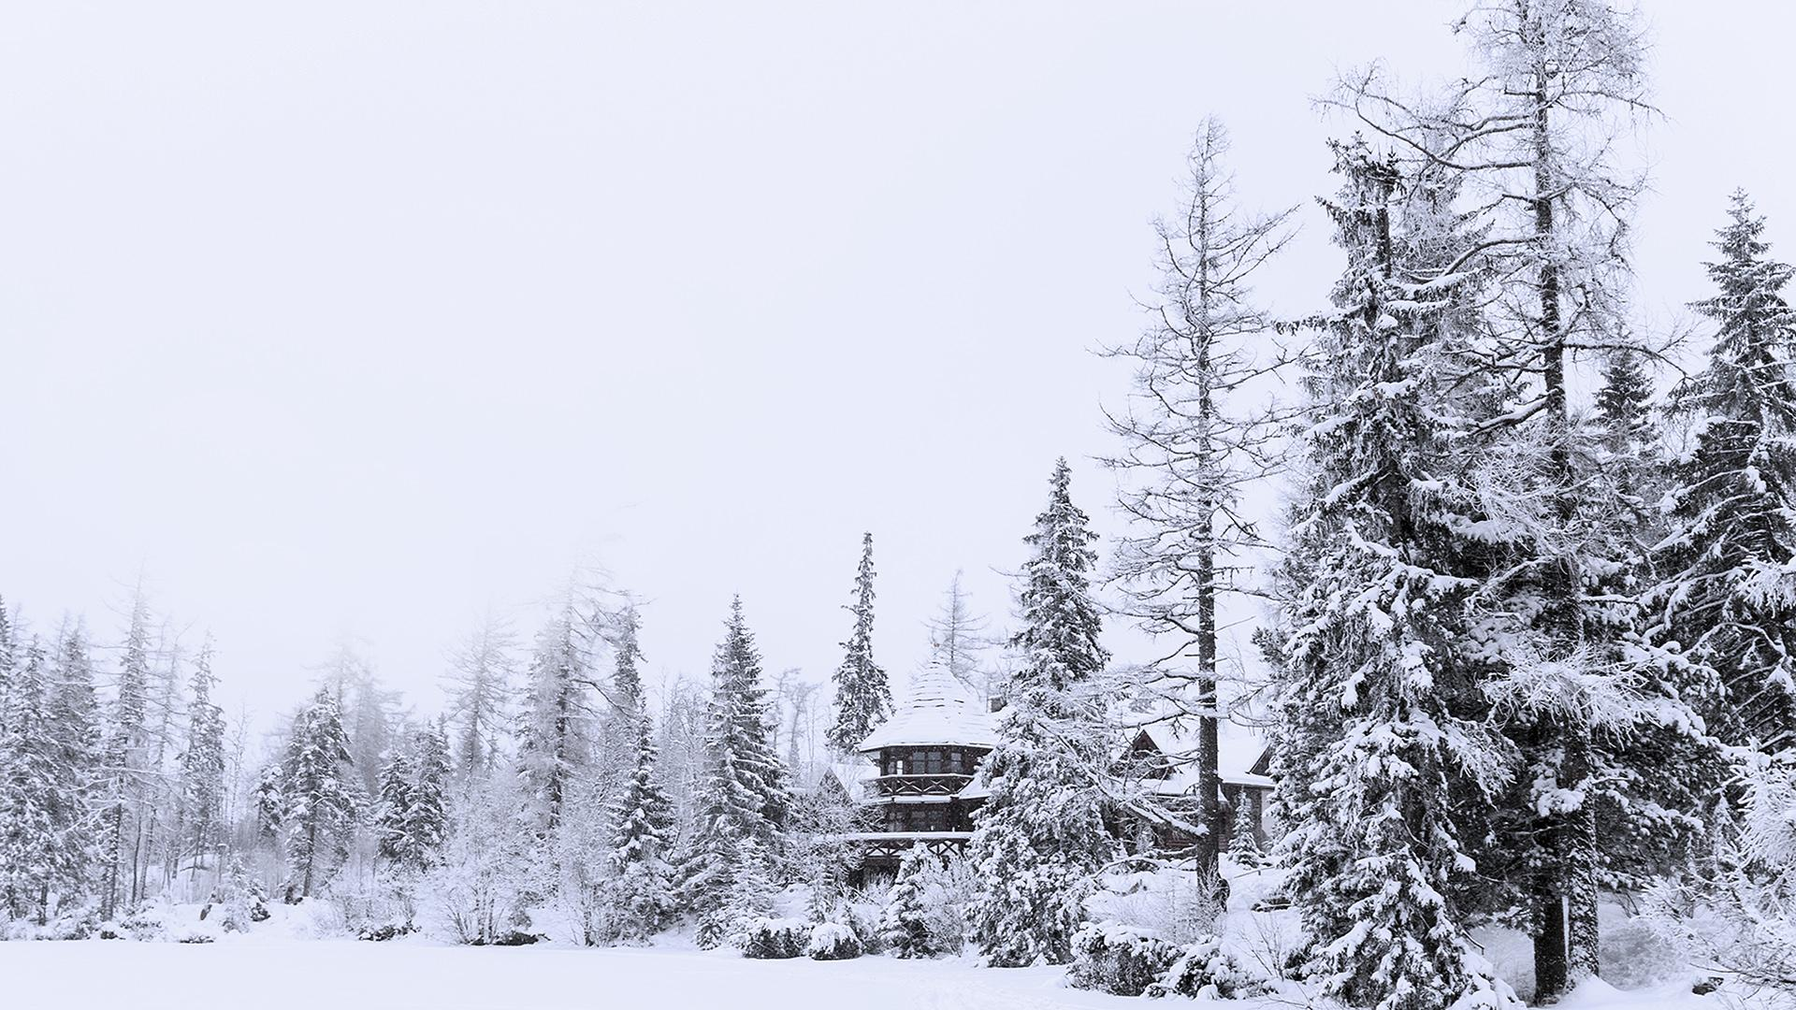
Price Analysis Report
The Big Mountain Resort
Presented by Yun Pang

Slide 2

TABLE OF CONTENTS
01
02
OVERVIEW
Recommendation
03
04
Modeling and Analysis
Conclusion
Introduction and problem identification
Proposed business option and key findings
Data processing, price predictive model and data analysis
A summary and conclusion of the report and presentation

Slide 3

01
OVERVIEW
Introduction and problem identification

Slide 4
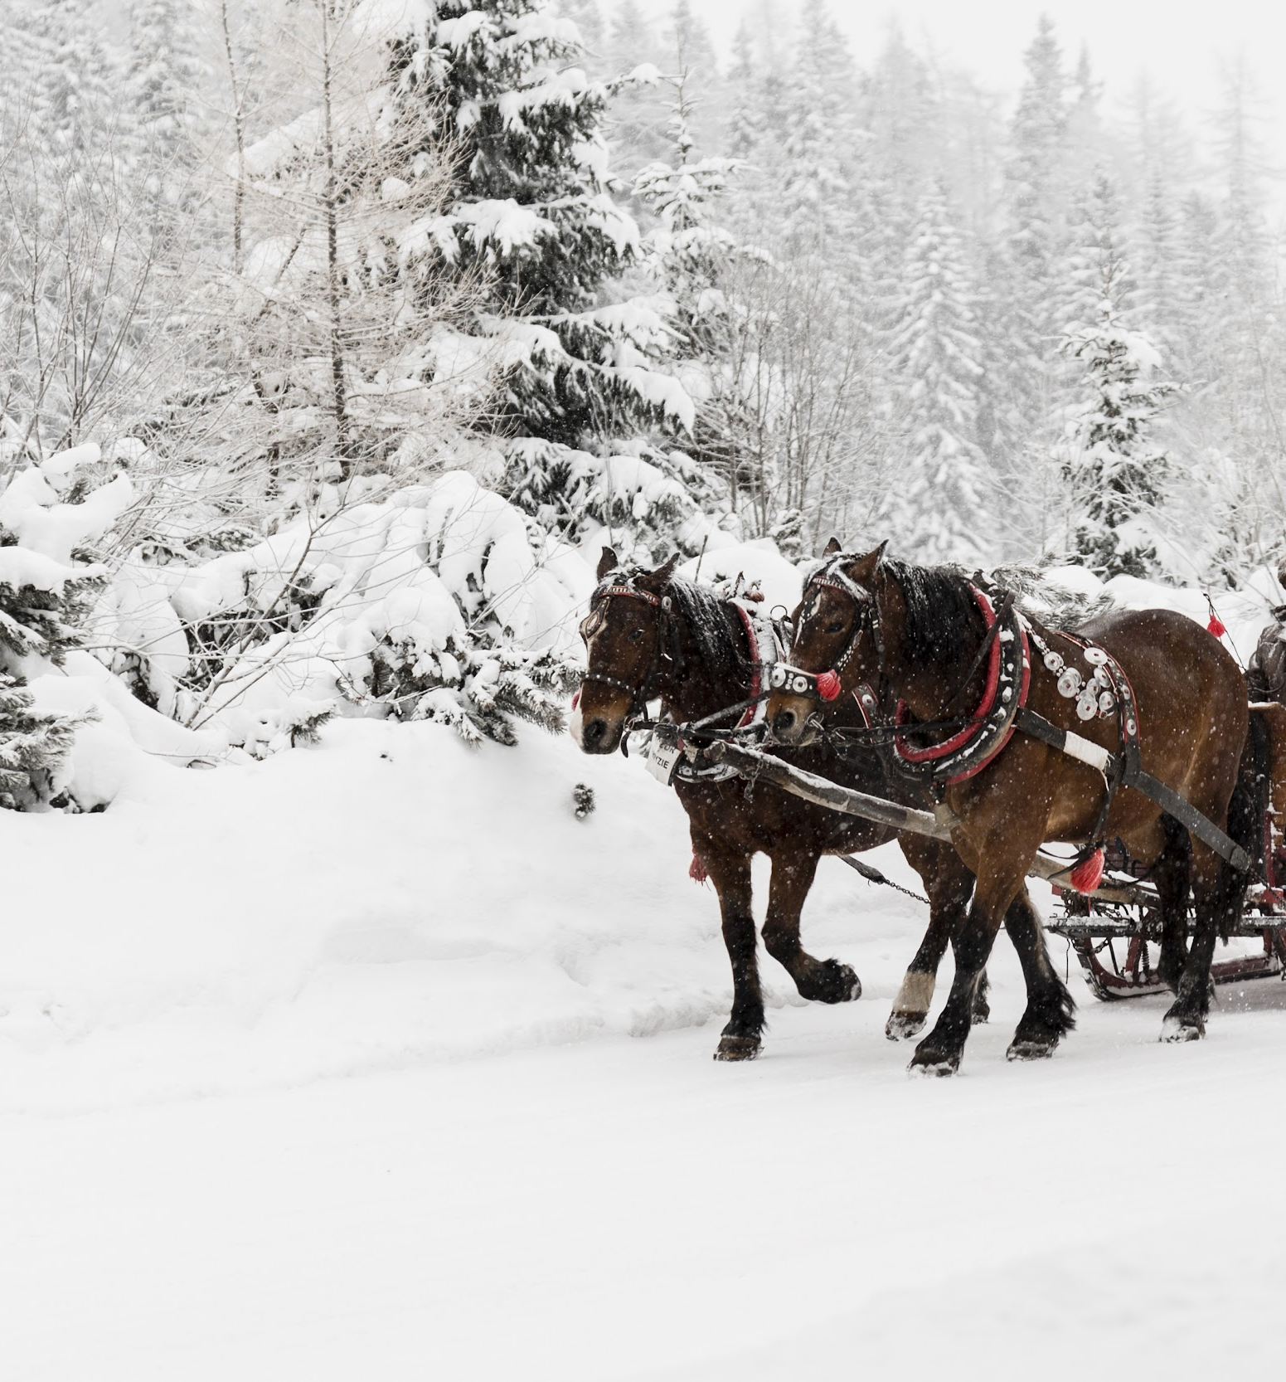
INTRODUCTION
The Big Mountain, which is a ski resort in Montana, charge for $81 ticket price.
Currently installed a new chairlift, which has a annual cost of 1.5M
Looking for a ticket price evaluation and business strategy to boost revenue

Slide 5
02 Recommendation
The current ticket price at $81 has a good support by the resort’s facilities, based on the analysis of ticket price and facility over 220 ski resorts.
Good approach to increase revenue:
Additional run
Additional chairlift
Increase vertical drop
A predictive price model is generated based on nationwide ski resort data analysis and random forest modeling
The three proposed options allow a increase of ticket price by $1.99

Slide 6
03
Modeling and Analysis
Data Processing, modeling and analysis

Slide 7
Data Processing
Data Source
Data Cleanup
EDA
Modeling
“Ski_resort_data”
Price and facility data of 330 nationwide ski resorts
State population data for resort density
Missing value removal
Filter and cleanup data based on states and region
Explore the ski resort price on state level and key features
Generate the best fit price predictive model

Slide 8
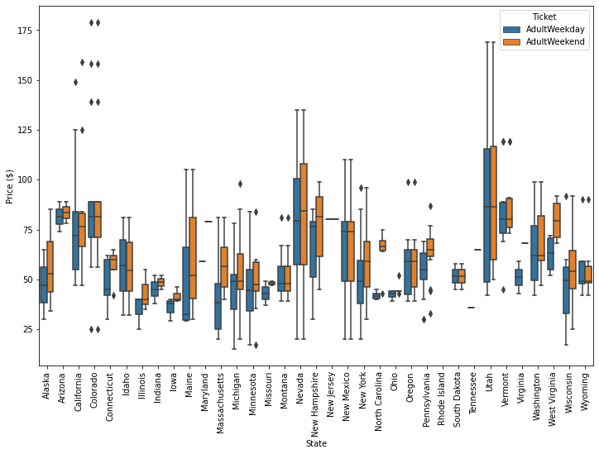
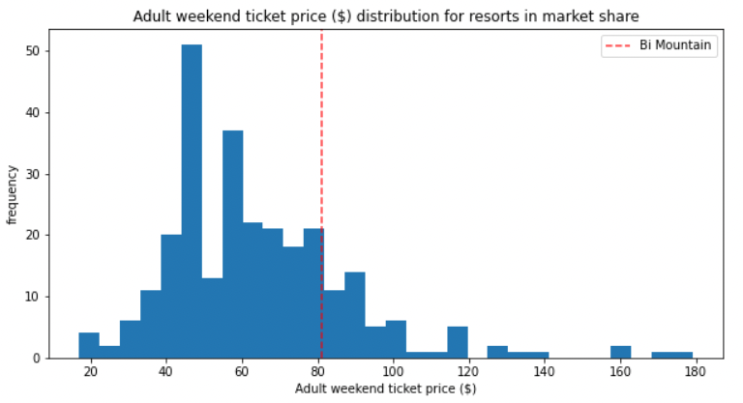
Analysis
Big Mountain ticket price is set at a higher end on its nationwide market segment
On state level, the adult weekend price > adult weekday price
Montana: adult weekend price = weekday price
Further analysis on adultweekend price

Slide 9
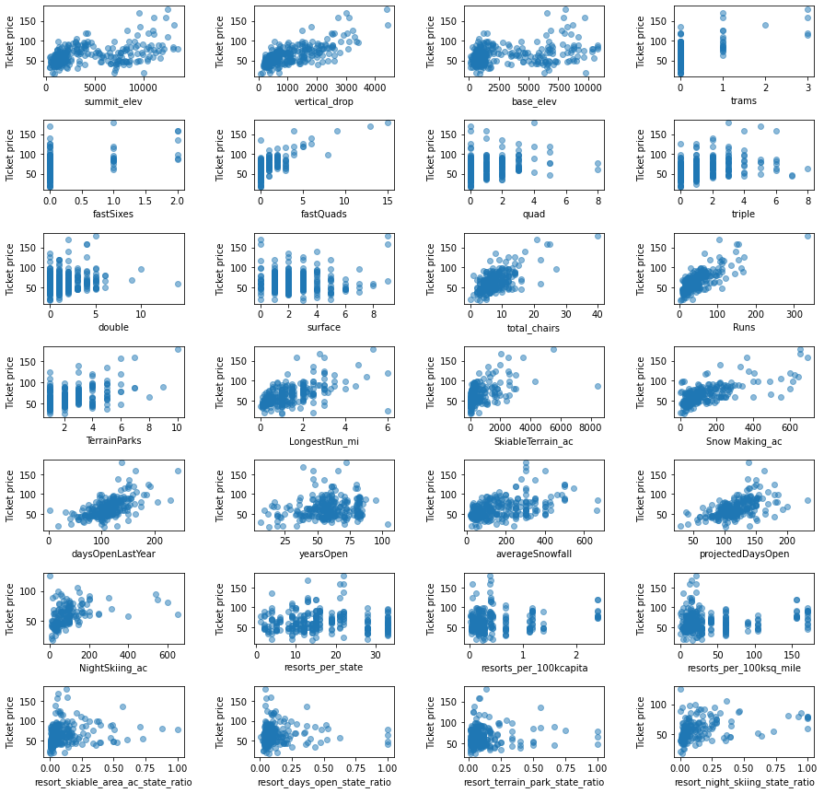
Key findings
Some features that play important role in ticket price
Vertical drop
LongestRun_mi
Total_chairs
Runs
SkiableTerrain_ac
Snow Making_ac

Slide 10
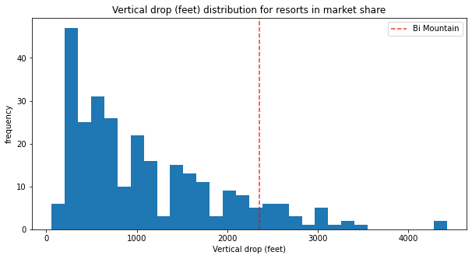
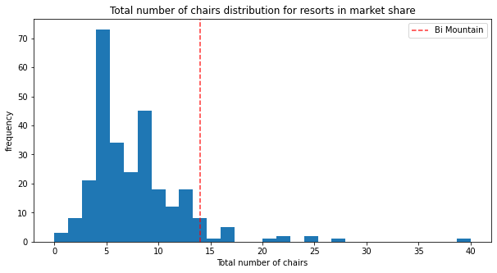
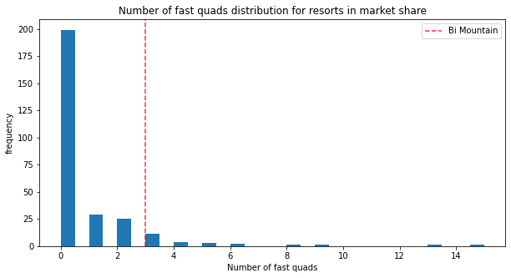
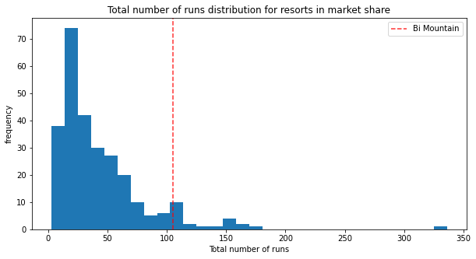
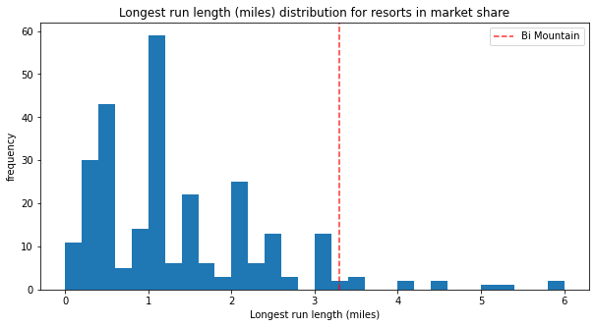
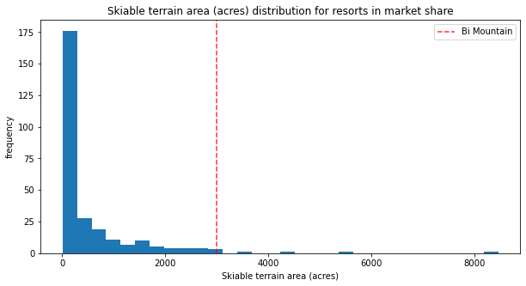
Key findings
Big Mountain price support features
Vertical drop
Snow maker coverage
Total runs
Fat quads
Run length
Skiable terrain area

Slide 11
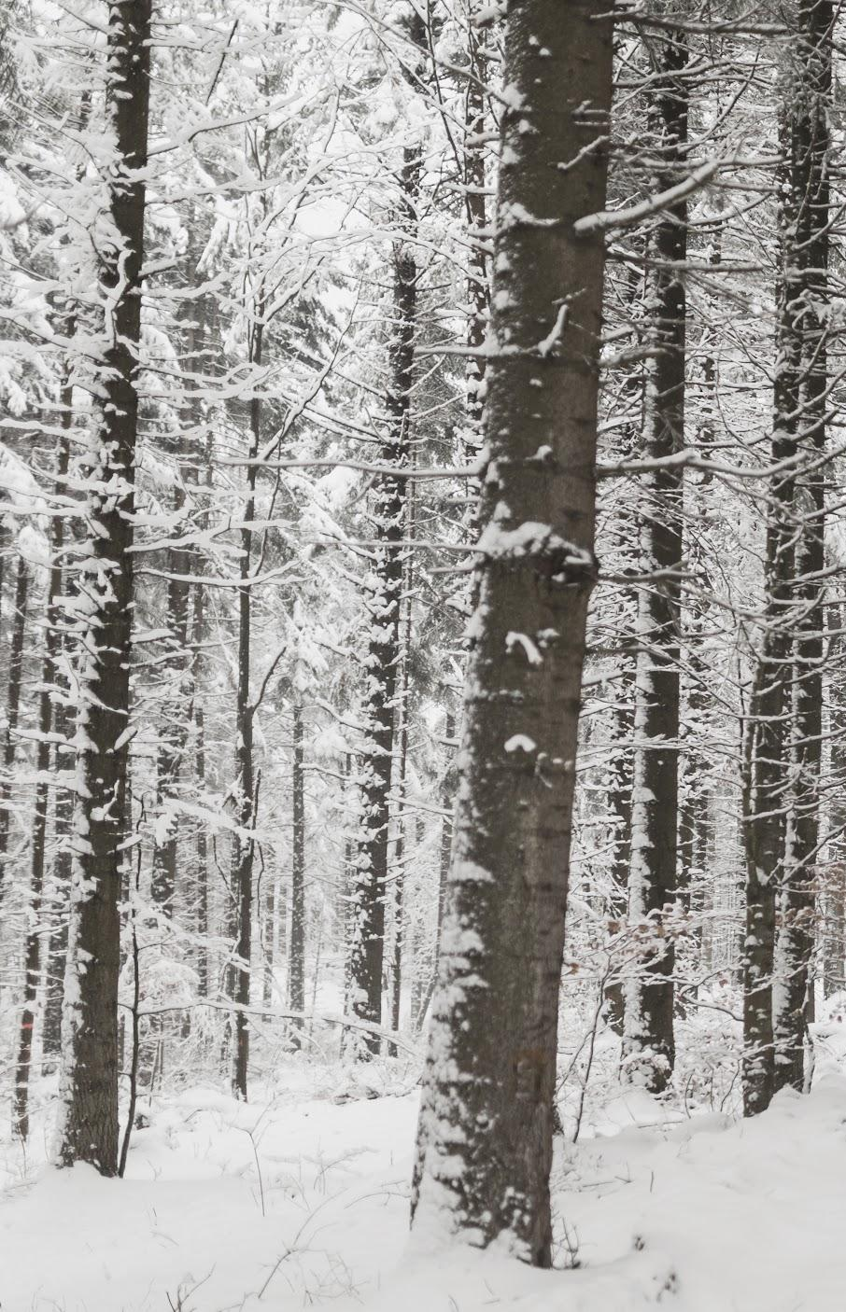
03 Model and Analysis
Random Forest is the best fit model for Big Mountain ticket price prediction
Model could be used for price prediction with possible change of business strategy
The model suggest the price has a $10 zoom for price increase, which is $91/ticket
Key features for modeling:
vertical_drop
Snow Making_ac
total_chairs
FastQuads
Runs
LongestRun_mi
trams
SkiableTerrain_ac

Slide 12
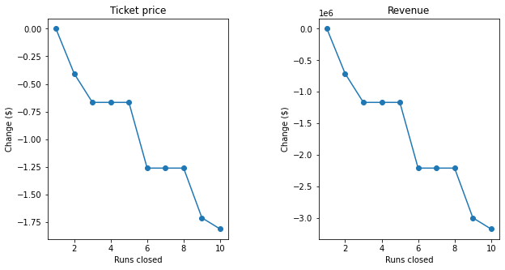
Modeling Scenario 01 - Closing Runs
Closing runs will have a significant negative impact on ticket price and revenue

Slide 13
Modeling Scenario 02
Modeling Scenario 03
Modeling Scenario 04
Adding a run, increasing the vertical drop by 150 feet, and installing an additional chair lift.
Condition from scenario 2, plus adding 2 acres of snow making
Increase the longest run by .2 miles, adding 4 acres of snow making capability.
This scenario increases support for ticket price by $1.99
Over the season, this could be expected to amount to $3,474,638
This scenario increases support for ticket price by $1.99
Over the season, this could be expected to amount to $3,474,638
Very small increase and make no difference in change of revenue
Bring in extra cost

Slide 14
Summary and Conclusion
Big Mountain is currently charging a price of 81 dollars for a weekend adult ticket. The price is at the higher end in Montana state. The price model suggest there is a $10 zoom for price increase.
Big Mountain has a good support for its ticket price by the nation-wide competitive large snow making area, large number of runs (including one longest run), and a large skiable terrain area.
It is not a good idea to close runs since it will significantly reduce the revenue if closing more than 2 runs.
It is not recommended to increase the longest run or snow coverage area as there is no difference on the price predicting model, and it may even increase the cost.
However, adding additional run, increasing vertical drop, and adding additional chairlift could be a good approach to increase the ticket price by 1.99 dollars, as well as the annual revenue.
If the management team is still considering closing runs, they may consider comparing the reduced maintenance cost to the reduced income from tickets, and test the difference on total revenue after closing runs.

Slide 15
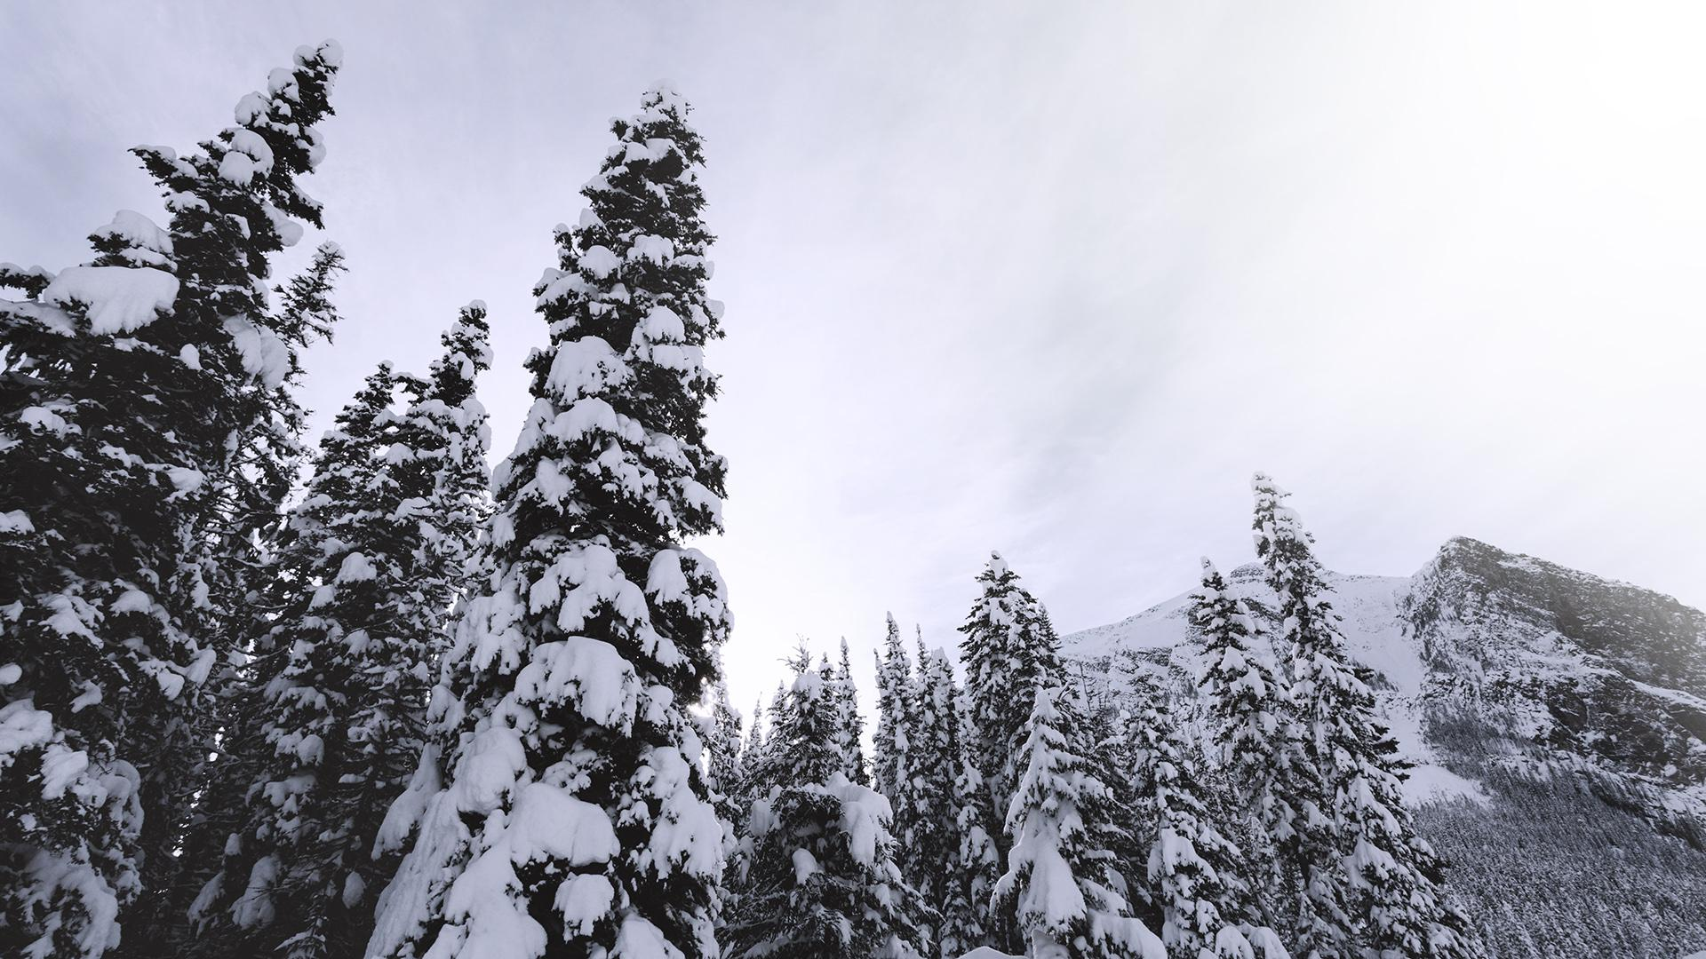
Thank You

